Slide 1

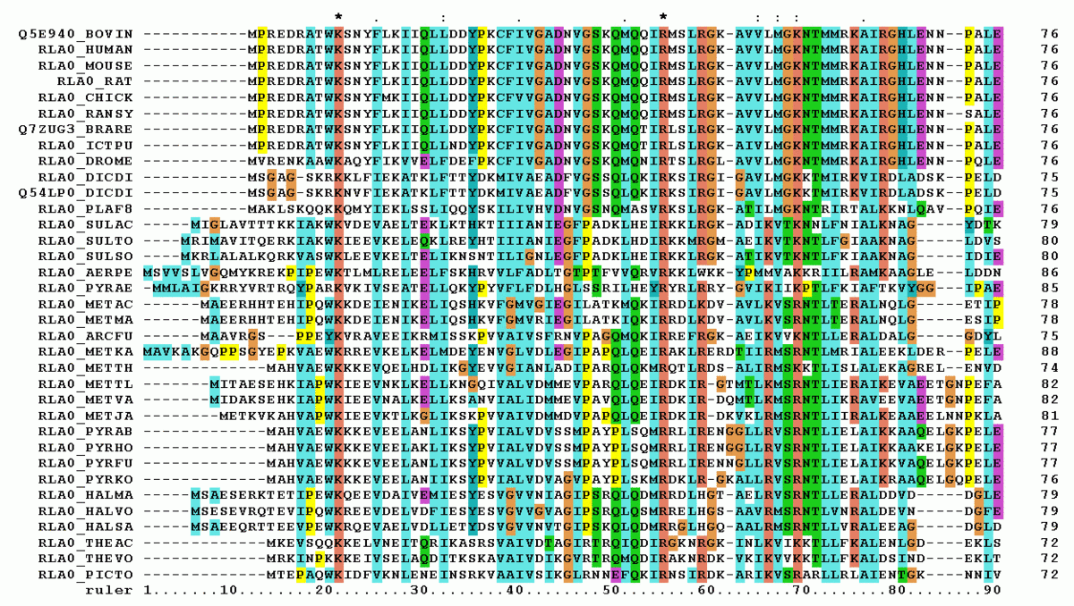
ML2223-15 Approve Prediction of Multisequence Learning
Prepared By Group 15:
Poonam Paraskar
Ankita Talande(1427349)
Pratik Desai

Slide 2
List of Contents

Slide 3
List of methods – 1. i. GetInputFromTextFile () – method to add input sequences through external text files i. Created new method in Program.cs for eliminating the hard coded inputs and getting from local text file. Ii. Splitted out the input sequences using regulare expression. ii. GetSubSequenceInputFromTextFile () - Method to read subsequences input from text files. 2. i. GetInputFromExcelFile() - Method to read the data from CSV file ii.GetSubSequencesInputFromExcelFile();

Slide 4
Hierarchical Temporal Memory
In this project we are using - Scalar Encoder
1. The main purpose for scalar encoder is to encode numeric or floating-point value into an array of bits, where the output has 0’s with an adjacent block of 1’s. The location of the block of 1’s varies continuously depending on the input value.

Slide 5
HTM consists of 2 different components: Spatial Pooler and Temporal Memory. 1. Spatial Pooler - Encoder produces output to be fed into Spatial Pooler algorithm. Type of Spatial Pooler (SP) that is used in this example is the multithreaded version that utilize multicore of the machine to run the spatial pooler algorithm. SpatialPoolerMT spatialPooler = new SpatialPoolerMT(hpa); patialPooler.Init(memory, UnitTestHelpers.GetMemory()); 2. Temporal Memory - The output of Spatial Pooler (SDR) is used as the input of Temporal Memory.Temporal memory algorithm will then learn the temporal pattern from spatial pattern. TemporalMemory temporalMemory = new TemporalMemory(); temporalMemory.Init(mem);

Slide 6
Program Flow

Slide 7
Output Screenshot

